Slide 1
物聯網實務 HW3
電機碩一 11278008 林佳慧
日期:2023/09/27

Slide 2
Exercise 3-1
Step 1:Install Node.js
Step 2:Install Node-RED
• Open Node.js command
• npm install -g --unsafe-perm node-red
Step 3: Run Node-RED
• node-red

Slide 3
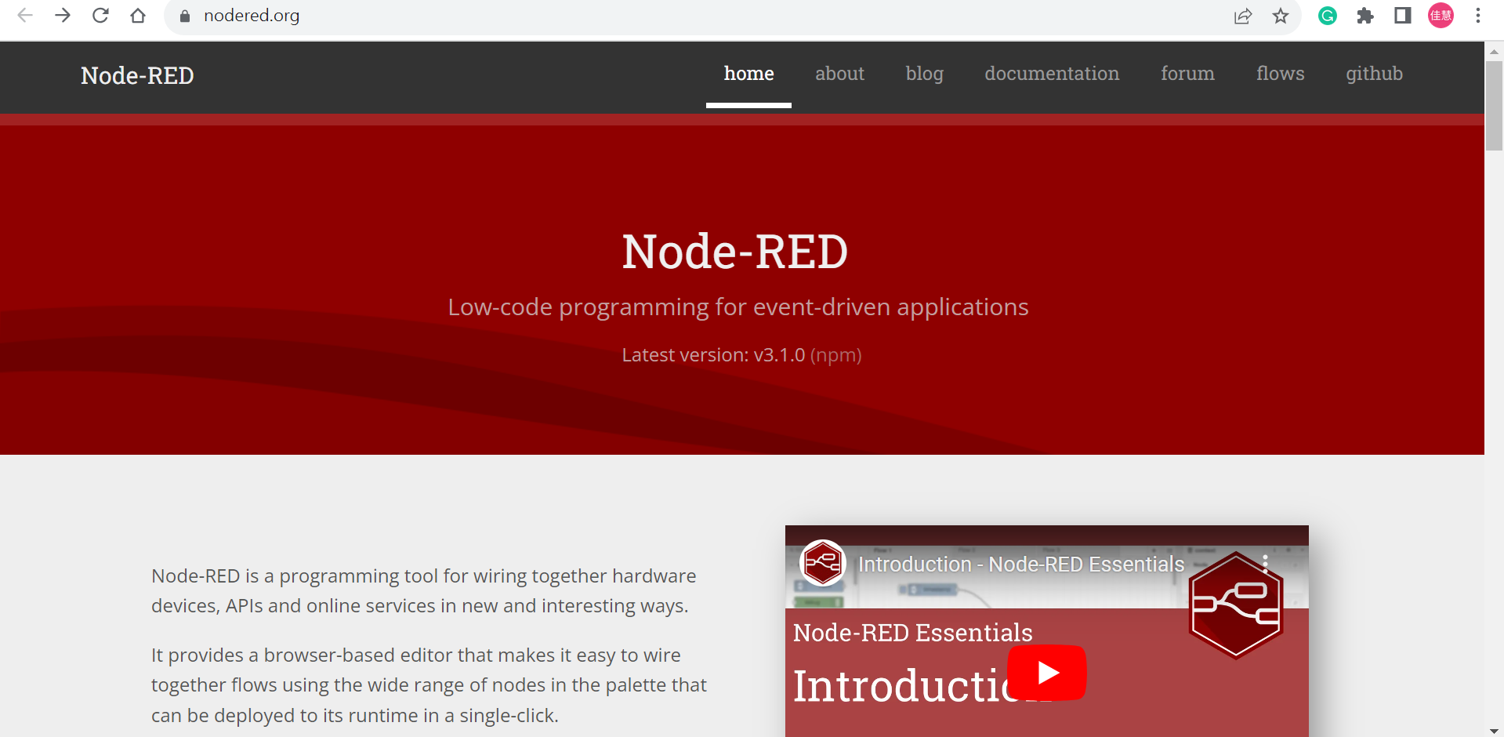
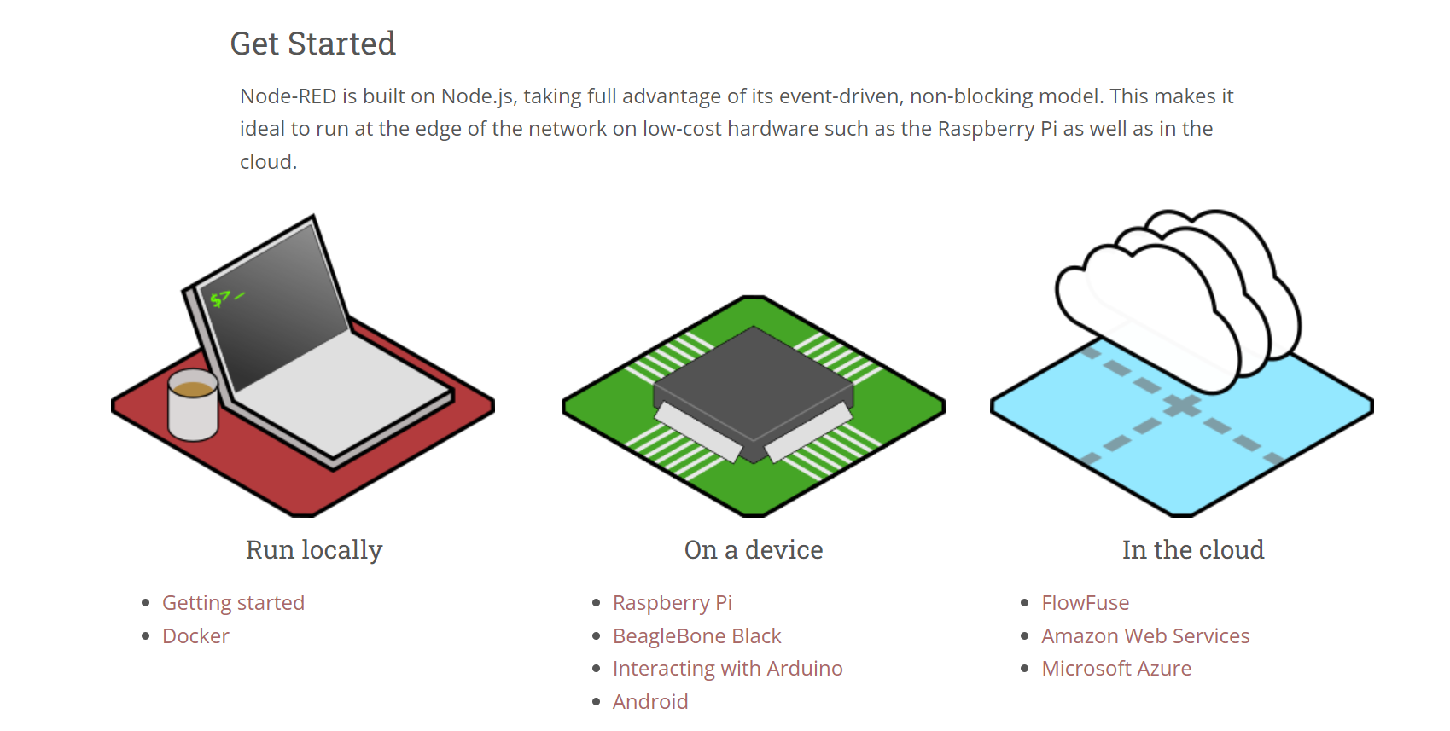
1. 到Node-RED網站https://nodered.org/
2. 下滑點選Getting started

Slide 4
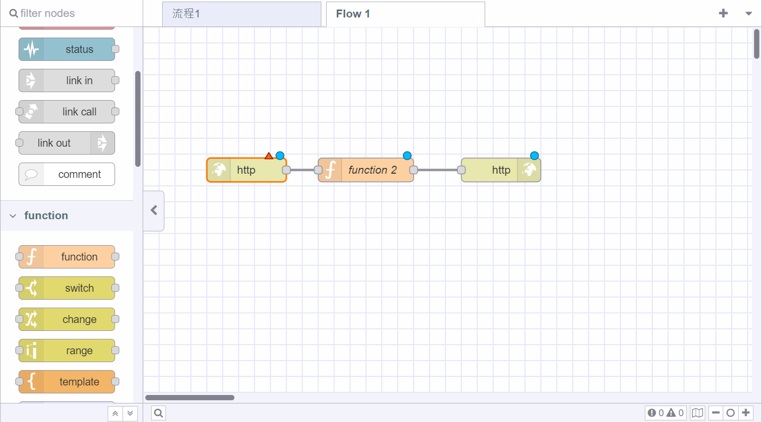

Slide 5
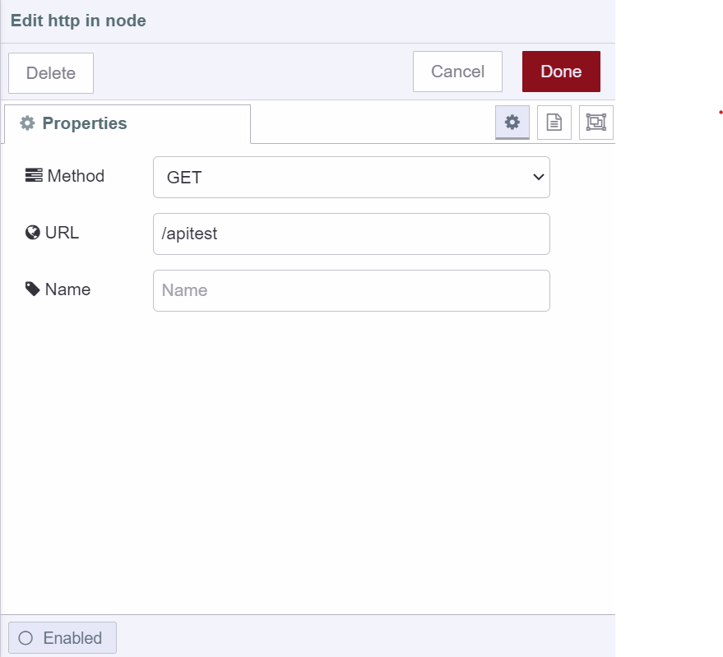
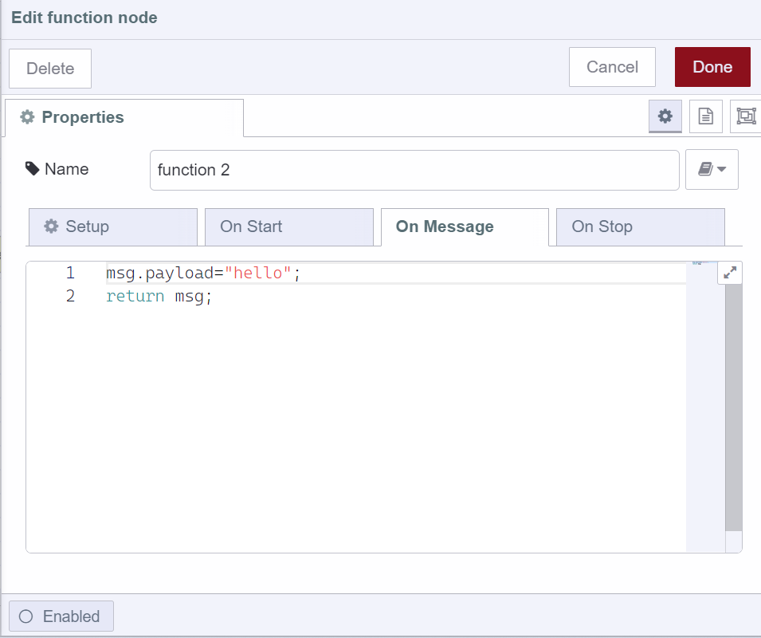
1. 到Node-RED網站https://nodered.org/
2. 下滑點選Getting started

Slide 6
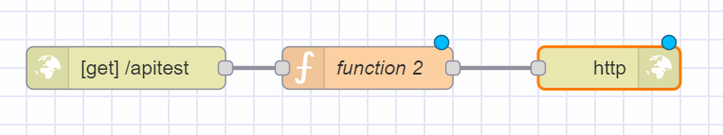
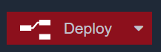
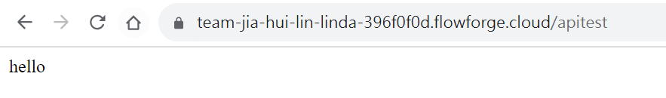

Slide 7
Exercise 3-2
• Send the http request with local Node-RED environment

Slide 8
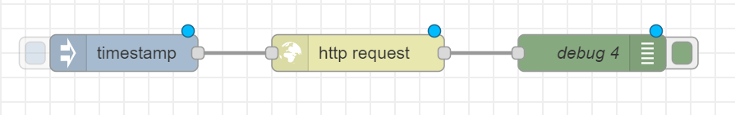
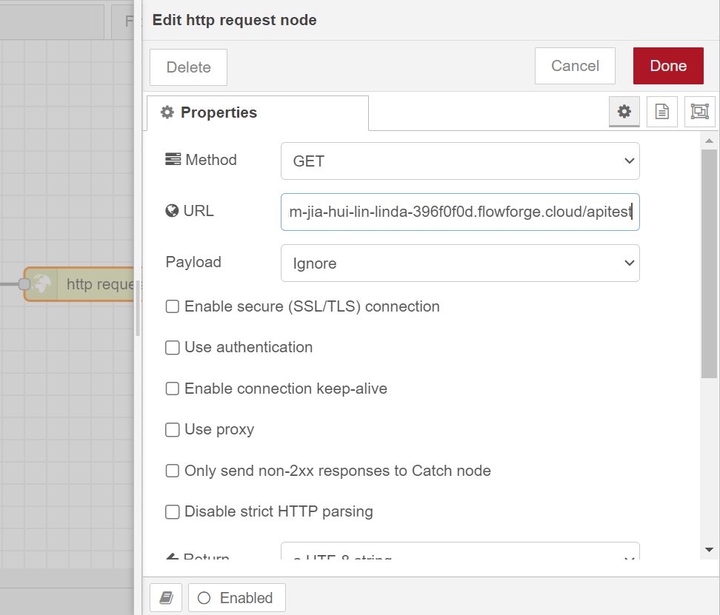

Slide 9
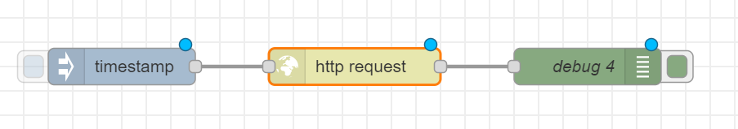
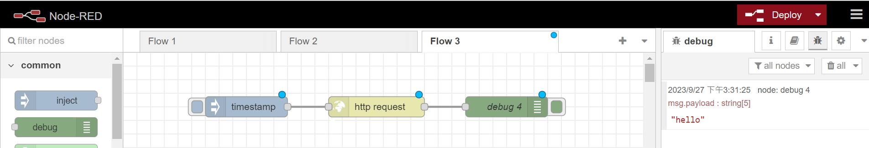

Slide 10
Exercise 3-3
Send the http request with the local Node-RED environment

Slide 11
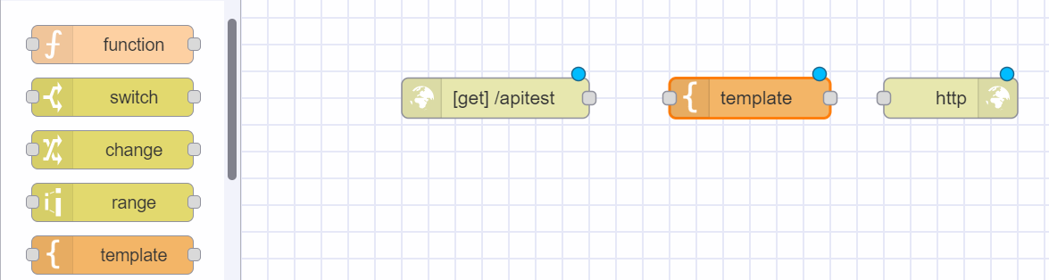
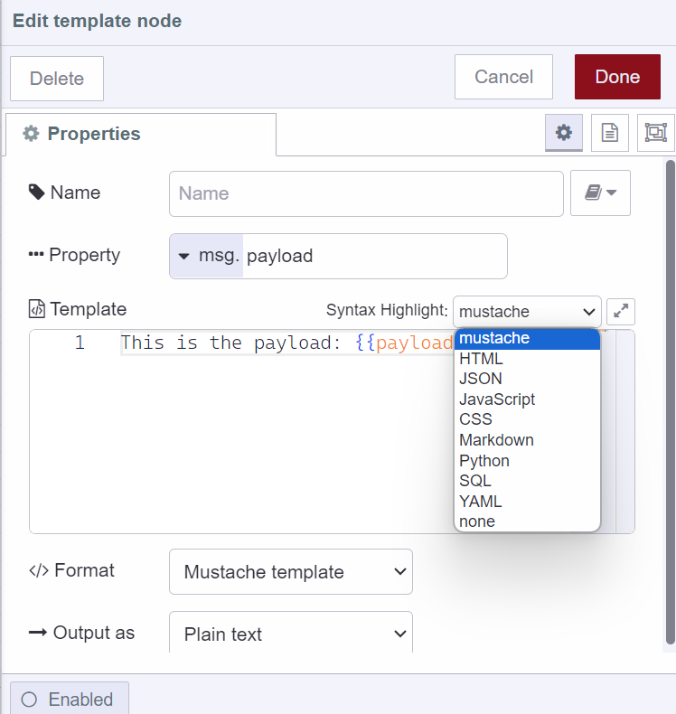

Slide 12
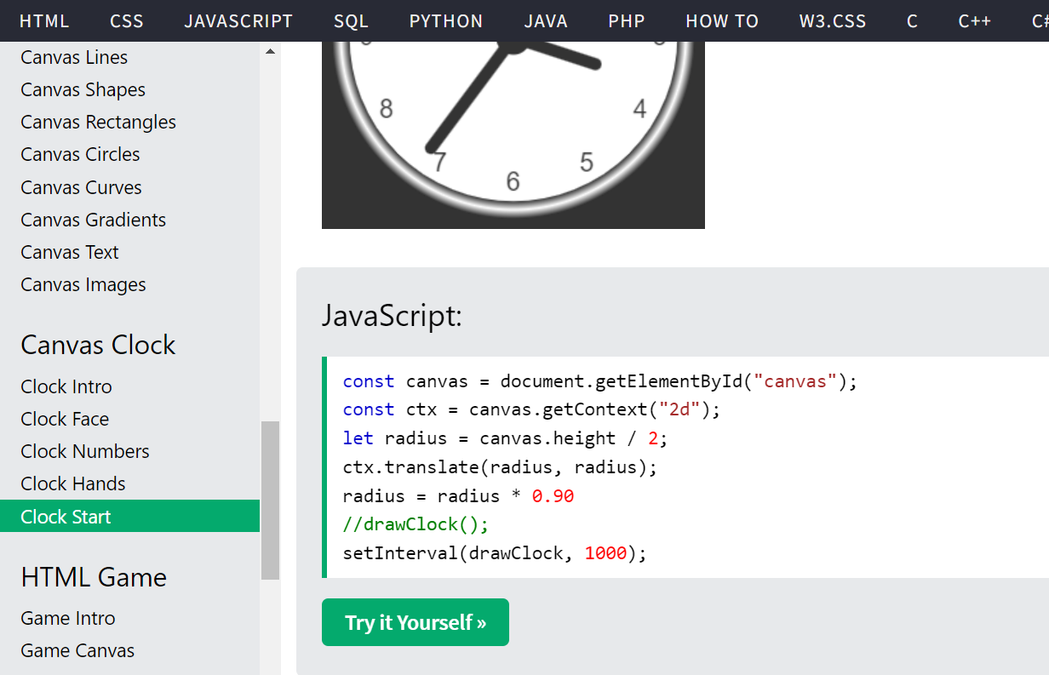

Slide 13
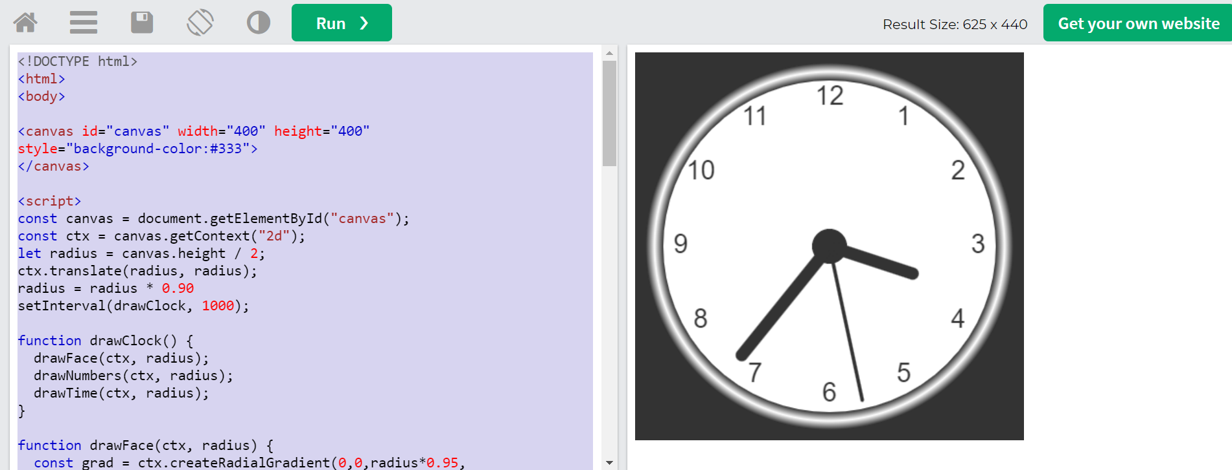

Slide 14
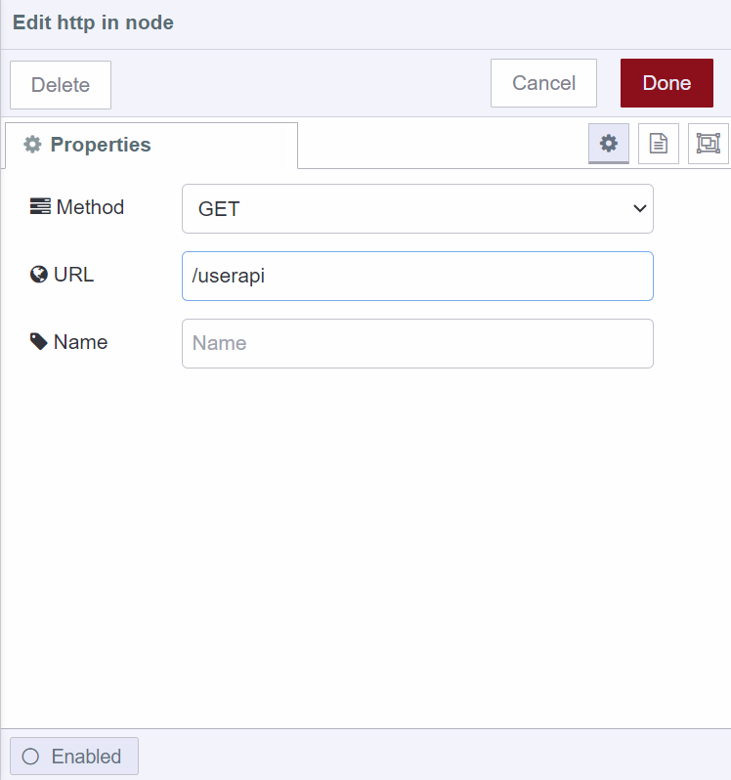
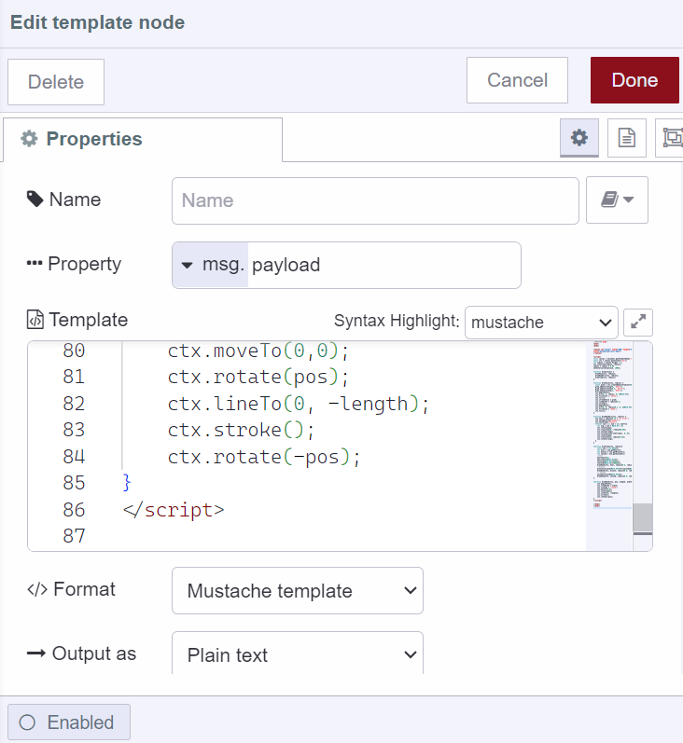
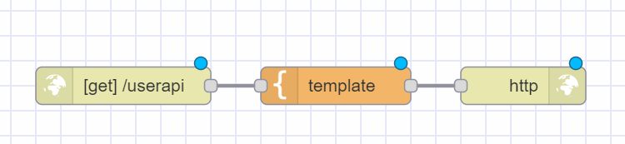
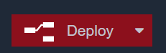

Slide 15
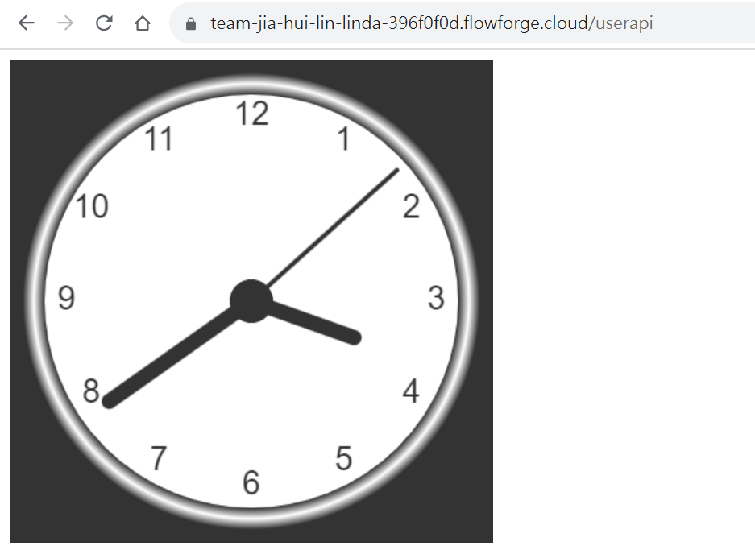

Slide 16
Homework 3-1
Test with your local Node-RED

Slide 17
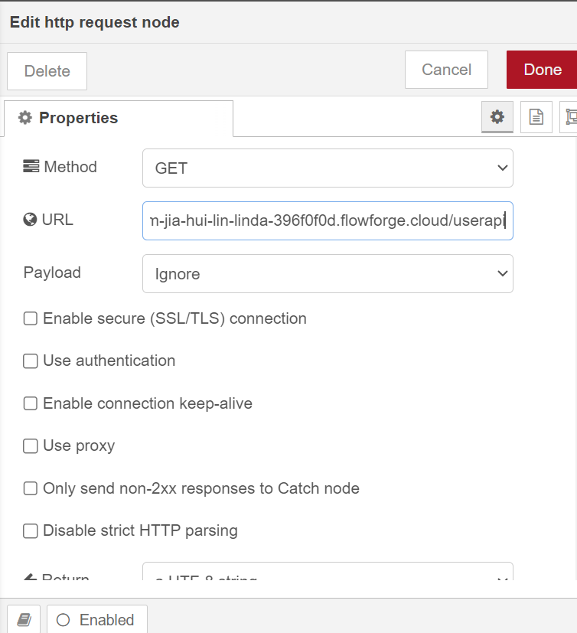
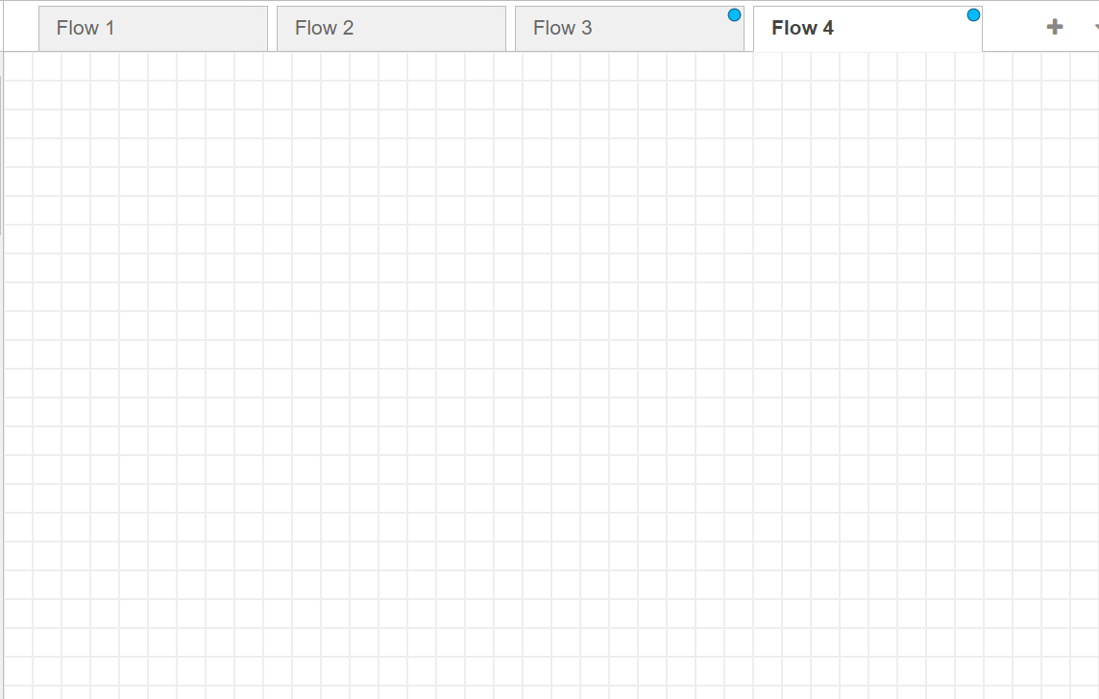
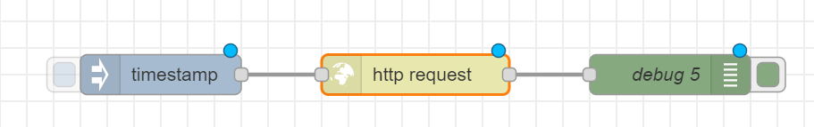


Slide 18
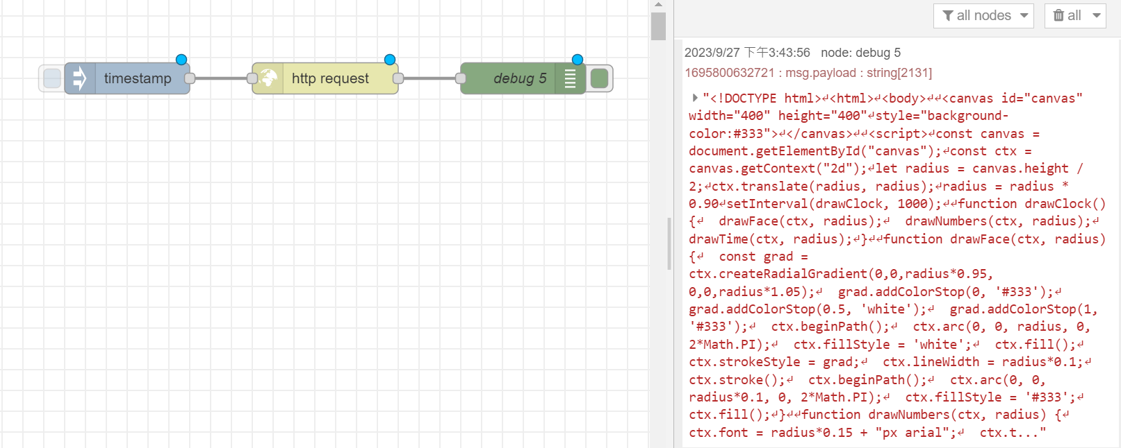

Slide 19
Exercise 3-2
Test with your local Node-RED

Slide 20
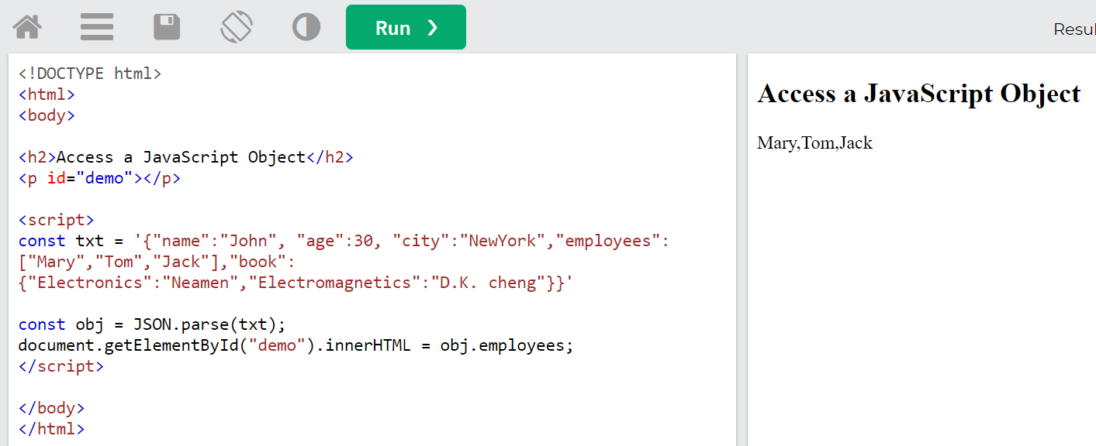
JSON.stringify(obj.employees)

Slide 21
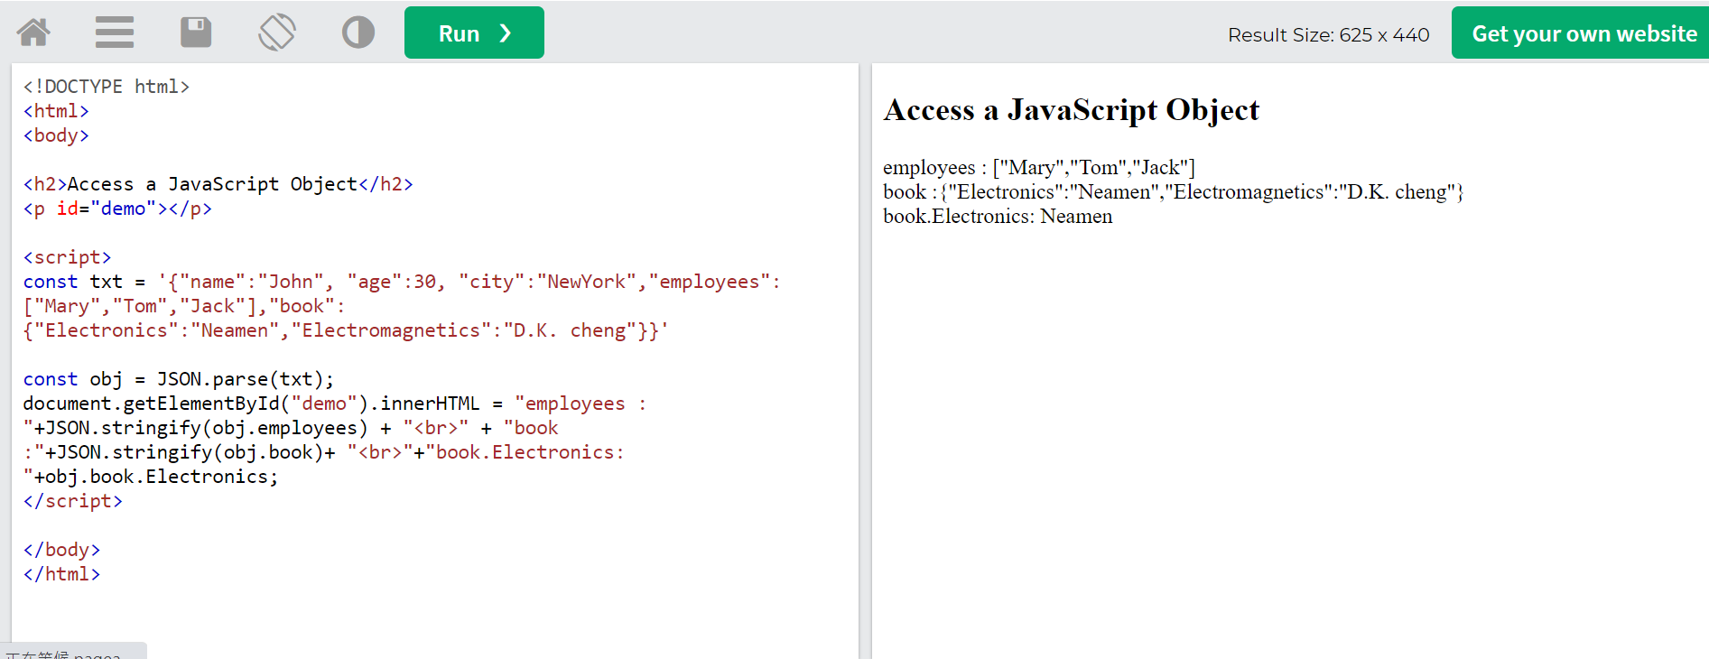

Slide 22
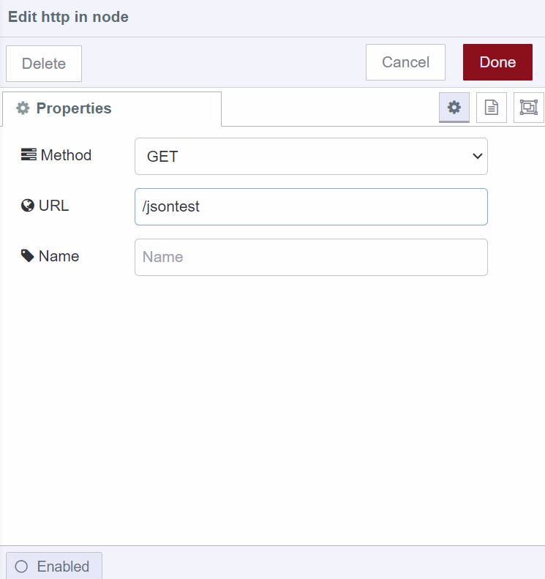
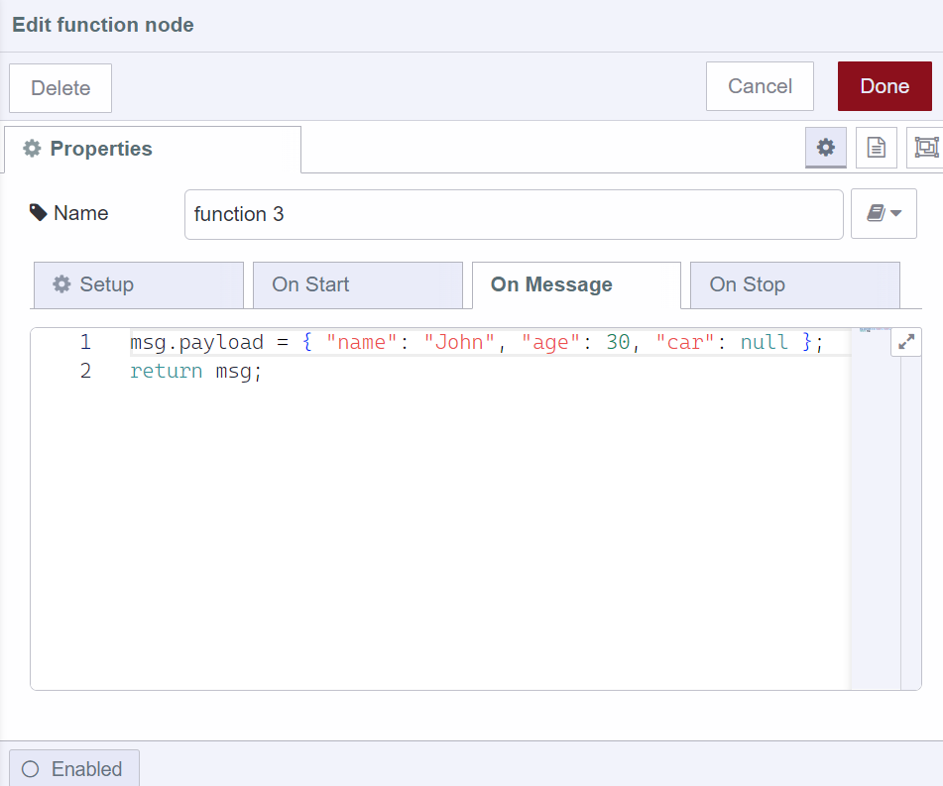
有哪些感測器

Slide 23
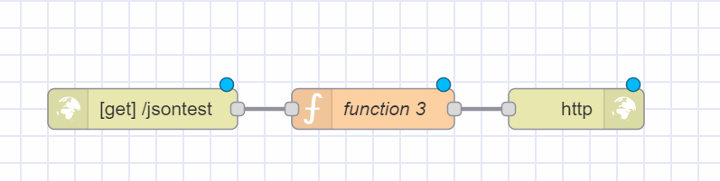
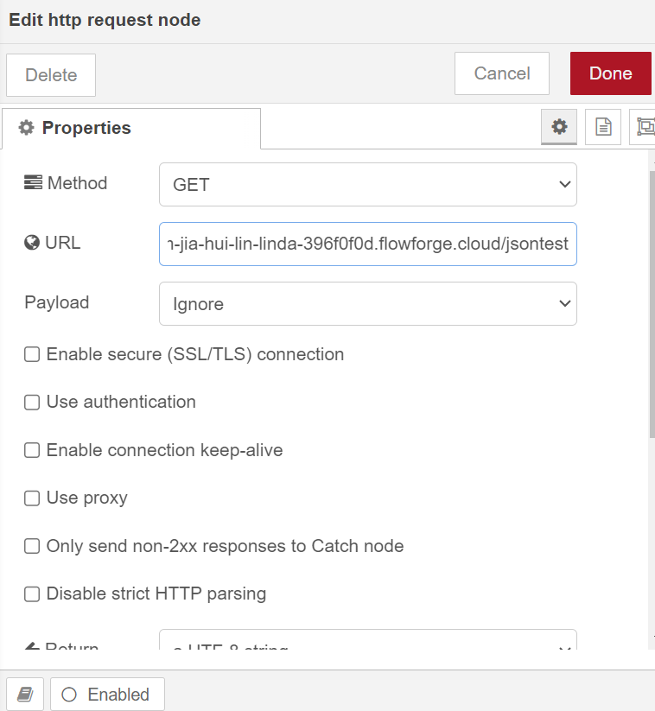
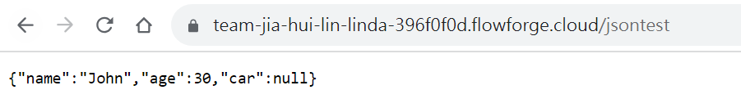

Slide 28
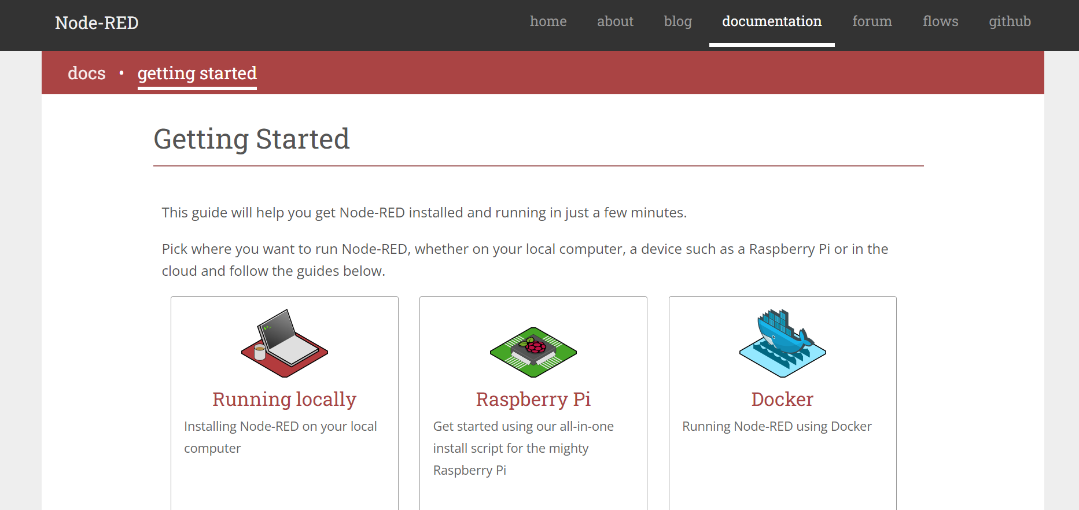
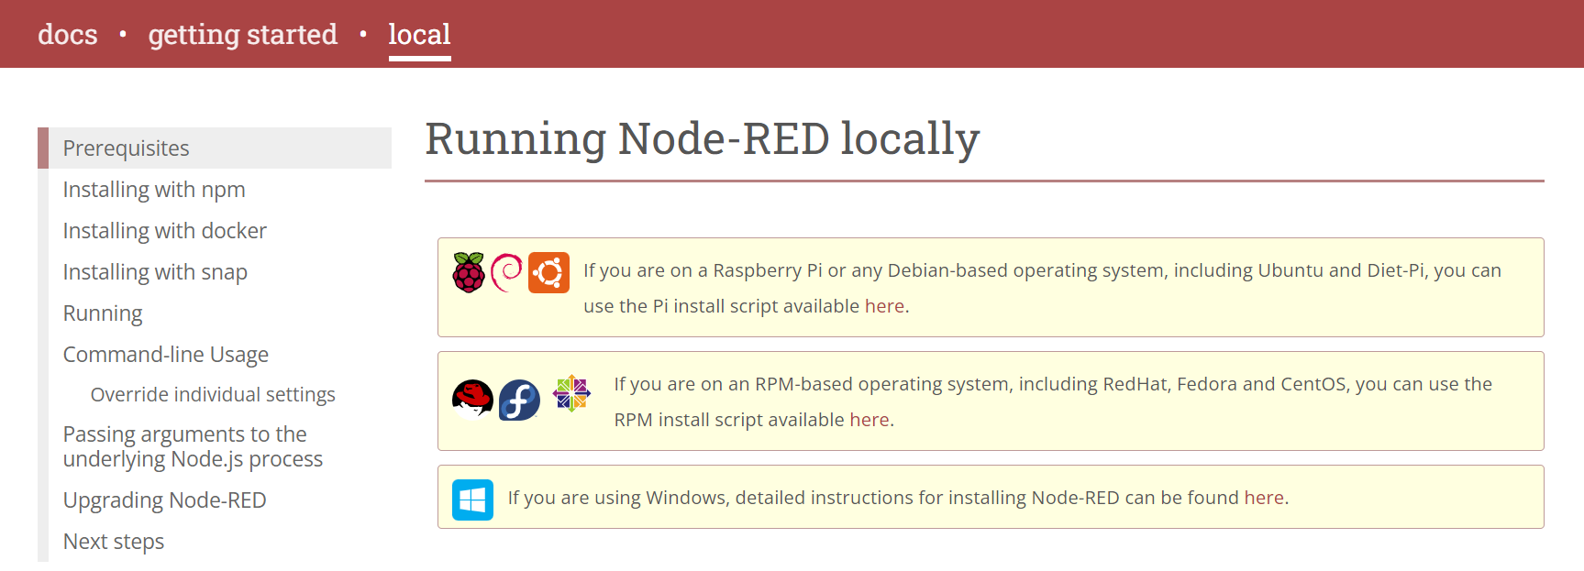
3. 點選Running locally
4. 點選here

Slide 29
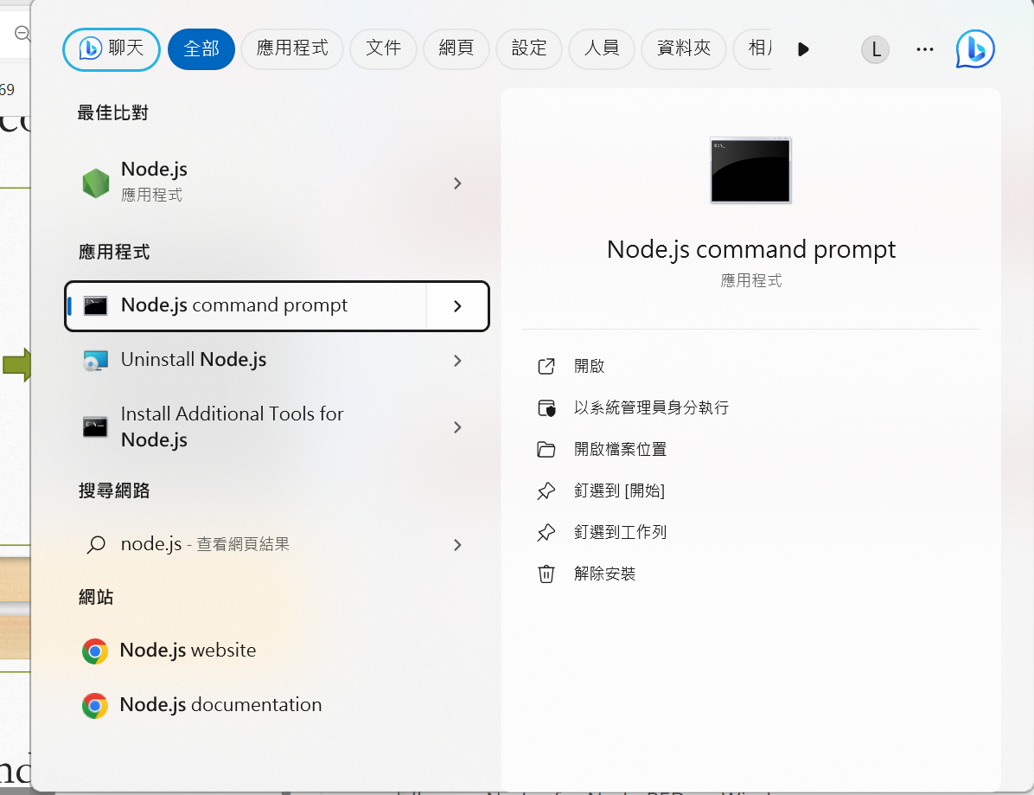
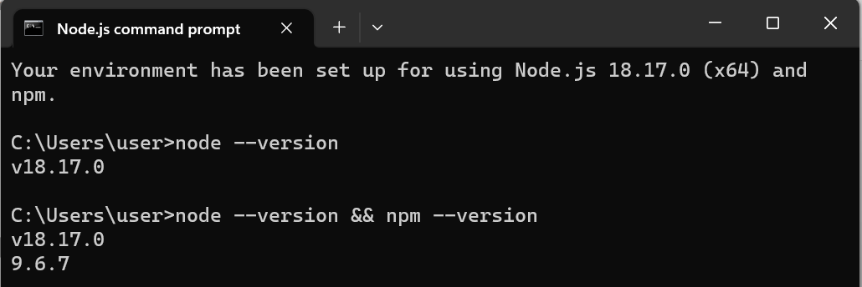
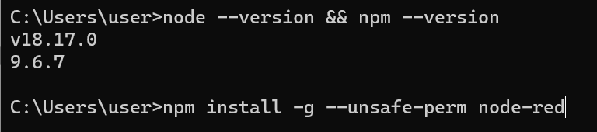
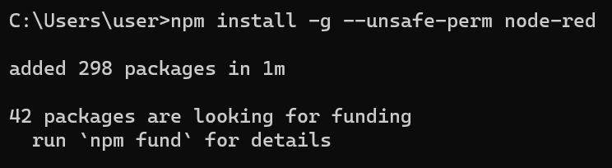
1. 因我之前有裝node.js，可在搜尋找到，點選node.js command prompt
2. Ensure Node.js and npm are installed correctly，輸入指令(node --version && npm --version)
Node以及npm的版本
3. Install Node-RED，輸入指令(npm install -g --unsafe-perm node-red)
4. 安裝完成

Slide 30
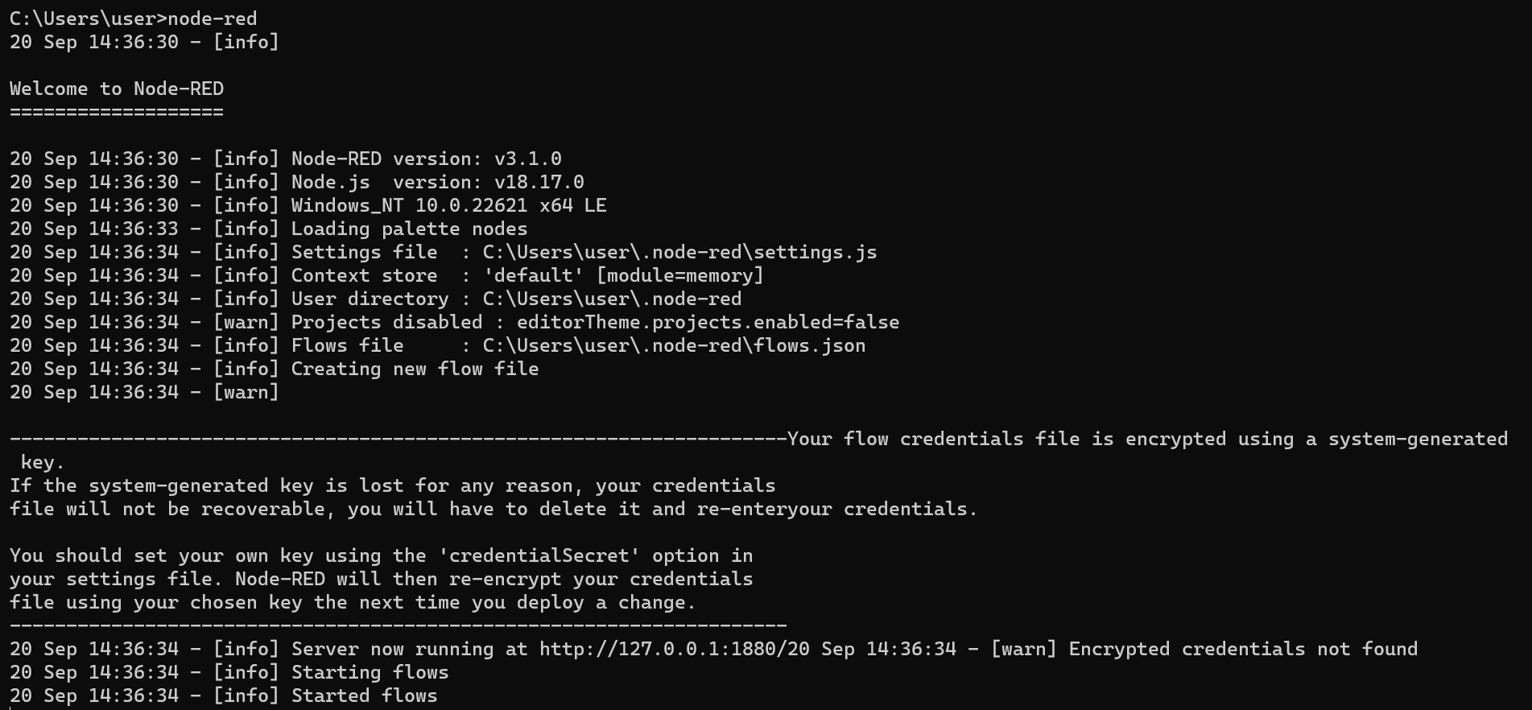
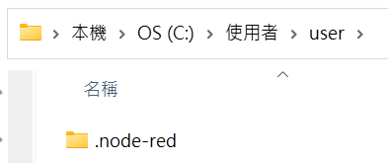
5. Run Node-RED輸入指令(node-red)
6. Check your userDir folder

Slide 31
Exercise 2-2
1. Access the editor
2. Add an Inject node
3. Add a Debug node
4. Wire the two together
5. Deploy
6. Inject
7. Add a Function node

Slide 32
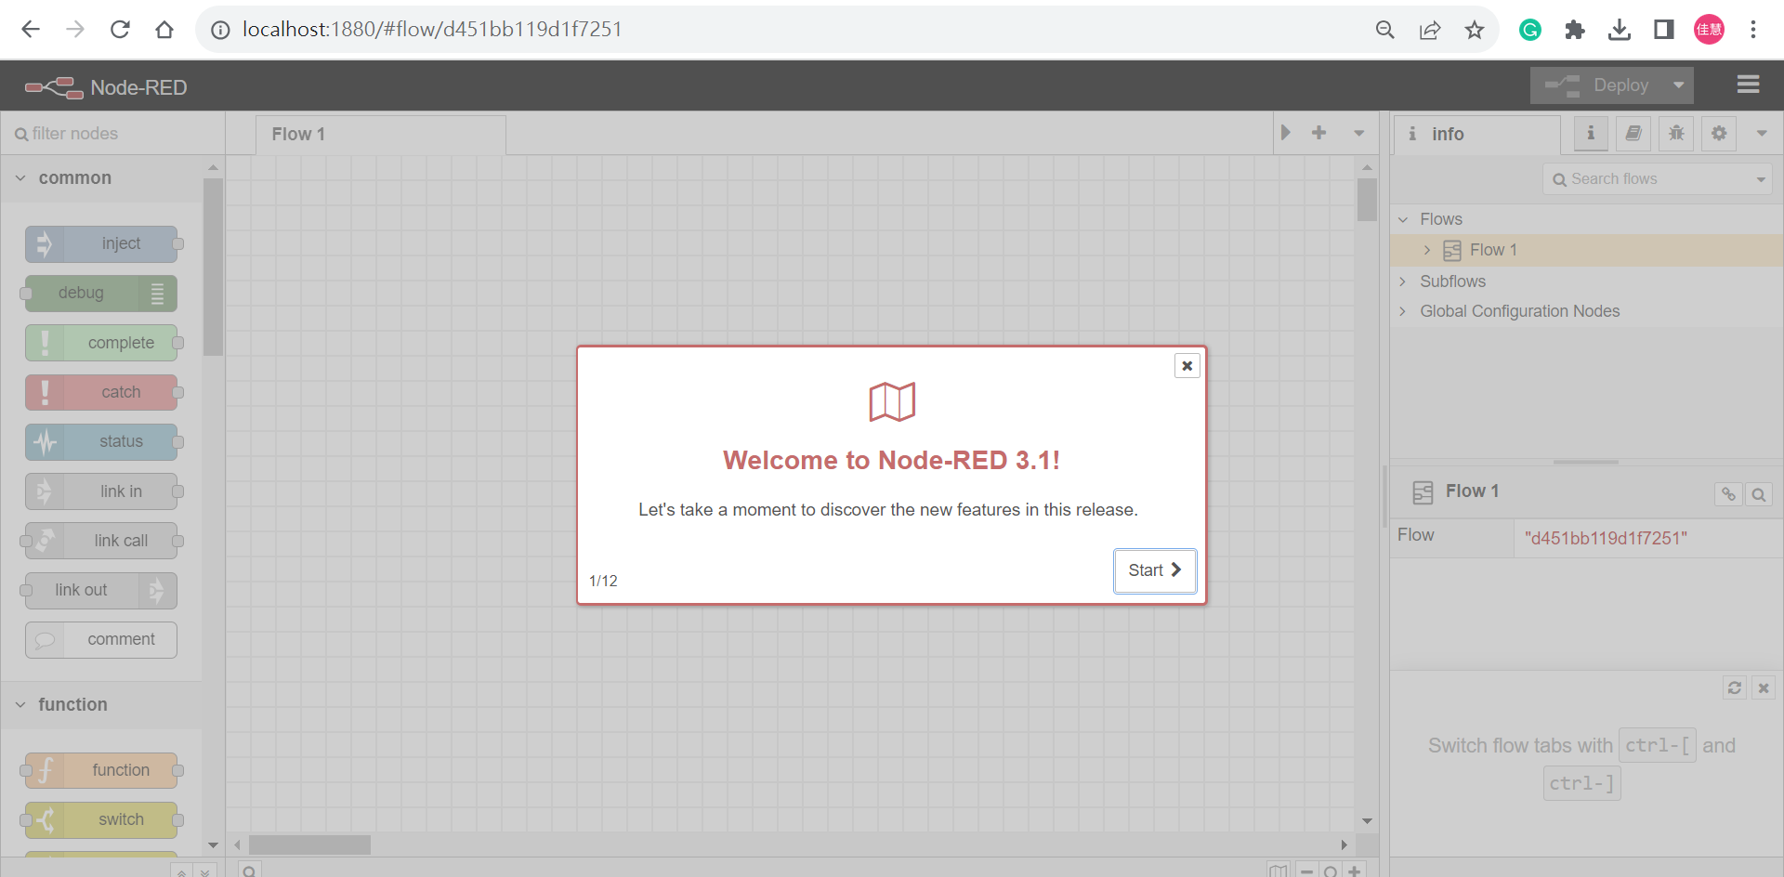
Open the editor in a web browser
http://localhost:1880

Slide 33
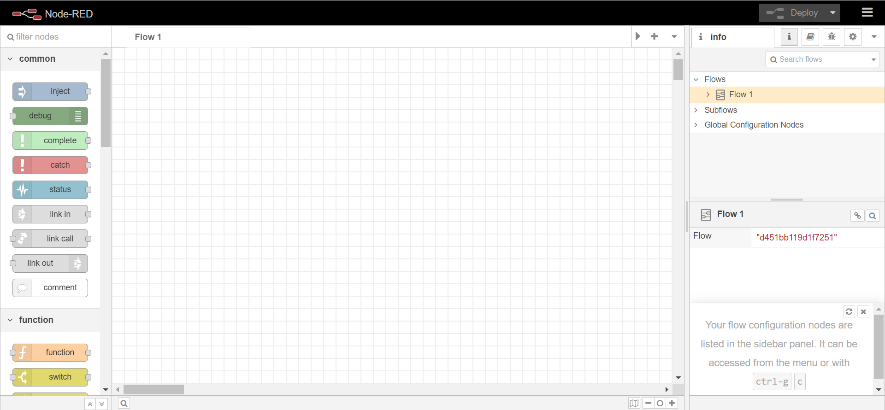
pallette
Information sidebar pane
workspace

Slide 34
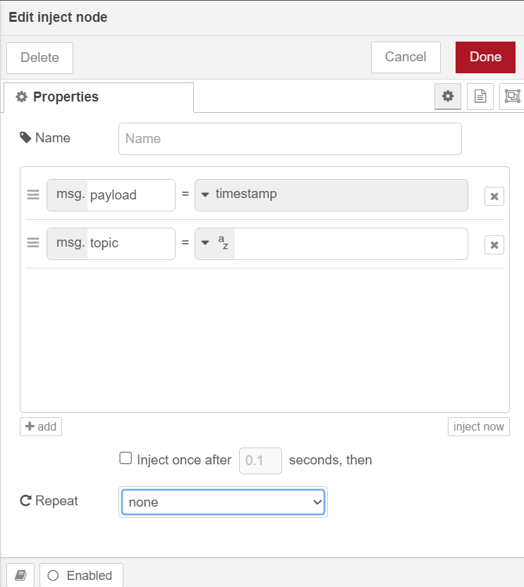
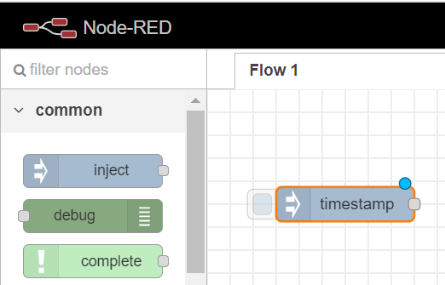
Add an Inject node
Double click

Slide 35
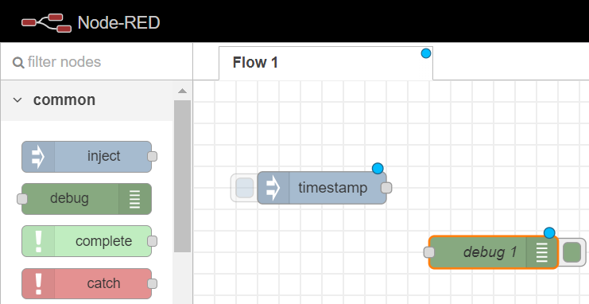
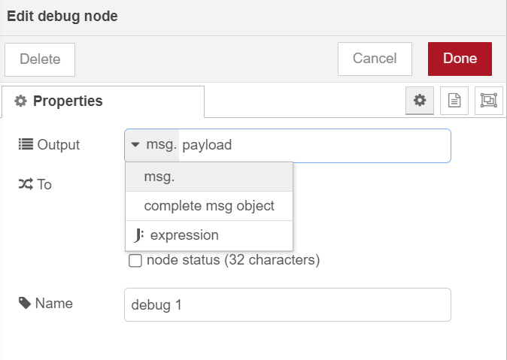
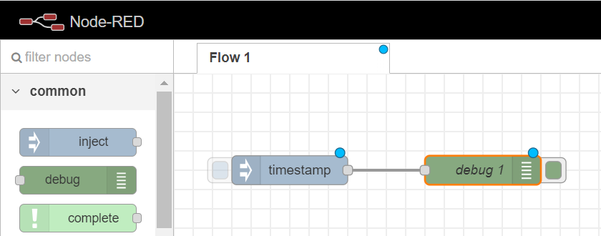
Add a Debug node
Wire the two together

Slide 36
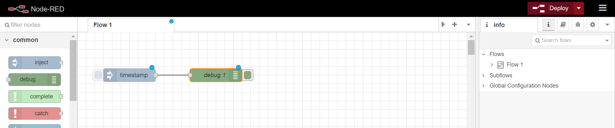
Deploy

Slide 37
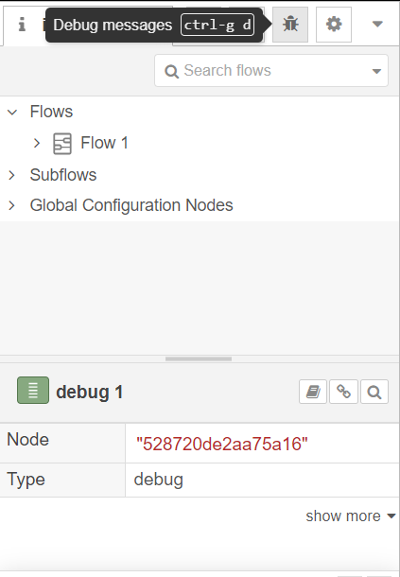
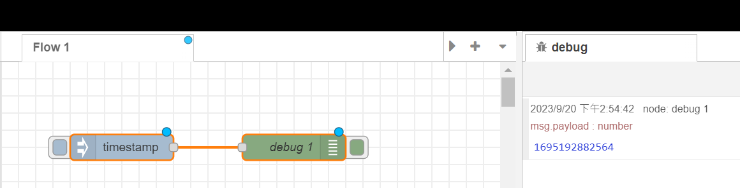
Inject
1. Debug messages
2. Click
The milliseconds since
January 1st, 1970

Slide 38


Add a Function node

Slide 39


Slide 40


Slide 41



3. Done
2. paste
copy
4. Deploy
1. Double Click

Slide 42

Trigger a flow
Click

Slide 43
Exercise 2-3
Export
Notes:
在第一個部分，我們又細項分成三個主要內容

Slide 44


1
3
2
4

Slide 45
Homework 2-1
Import flows.json to FlowFuse

Slide 46


1
2

Slide 47


1. copy
2. Paste
3. import
https://nodered.org/docs/tutorials/first-flow

Slide 48


可檢查與自己拉的方塊裡設的功能是否正確

Slide 49
Homework 2-2
Creating your second flow

Slide 50


Slide 51

Follow this page
https://nodered.org/docs/tutorials/second-flow

Slide 52


1. Add an Inject node
1. Click here to add a new Flow
2. Add an Inject node

Slide 53


6. Done
3. Double click
4
5. every 5 minutes

Slide 54



2. Add an HTTP Request node
3. Done
2. Paste
Add an HTTP Request node
1. Copy

Slide 55


3. Add a CSV node
Click this

Slide 56


4. Add a Debug node
5. Wire them all together

Slide 57

6. Add a Switch node
1

Slide 58



5
3. 輸入payload.mag
4
2
6. Add a second wire from the CSV node to this Switch node.

Slide 59

7. Add a Change node
1

Slide 60


2. Select string and input “PANIC!”
3. Wire them together

Slide 61

8. Add a Debug node
1
2. Wire them together

Slide 62

9. Deploy

Slide 63



從左側兩圖可看到，因為我們有坐設定。所以右側的結果顯示出當mag>=7的時候，會有PANIC!出現。因為所有結果只有一個符合條件，所以出現一次PANIC!。

Slide 64

透過import 來驗證我們拉的是否正確
1
2
3.copy
https://nodered.org/docs/tutorials/second-flow

Slide 65

4. Paste

Slide 66


Slide 67

細看裡面的值，與我們選的一樣

